Slide 1


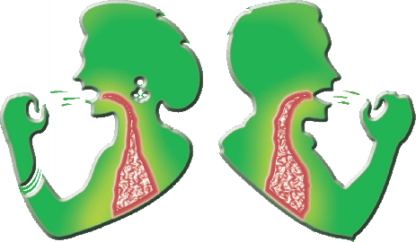


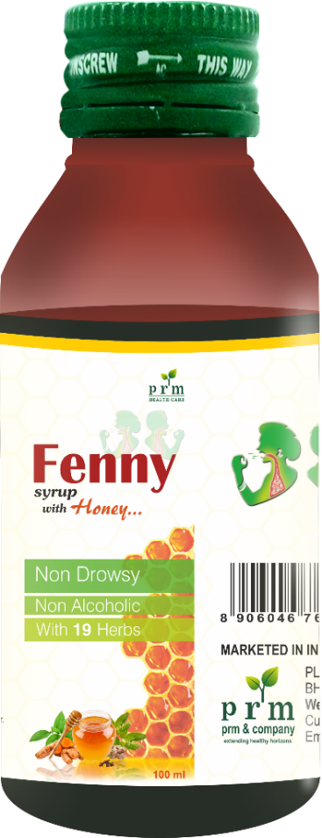

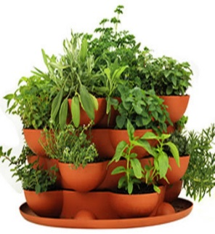
100 ml
Made with 19 Herbs Namely
Tulsi, Ardusi, Pudina Pan,
Nilgiri Oil, lavang oil etc…
Palatable Honey Taste
Cares & Cares All Age
Natural Herbs
For the use of regd. Medical practitioner only
PURE HONEY

Slide 2

Why Fenny Syrup ?
100% Ayurvedic syrup for Sore throat & Dry cough with Honey Flavour.
Made with 19 premium herbs like Tulsi, Pudina, Nilgiri, Honey, Etc.
Economy MRP and best channel margin.
100 ml
For the use of regd. Medical practitioner only
PURE HONEY
Natural Herbs

Slide 3
Contains :
Each 5 ml. contains extract of :
Ardushi leaves (Adhatoda vasica) 300 mg. A.B.
Tulsi leaves (Ocimum sanctum) 175 mg. A.B.
Adrak rhizome (Zingiber officinalis) 200 mg. A.B.
Kantakari panchang (Solanum xanthocarpum) 50 mg. A.B.
Haldi rhizome (Curcuma longa) 100 mg. A.B.
Phudina ka phool Crystal (Mentha spicata) 30 mg. A.B.
Suddha suhaga powder 20 mg. A.B.
Tejbal chhal (Cinamonum zeylanicum) 25 mg. A.B.
Somlata leaves (Sarkostol brevistigma) 150 mg. A.B.
Bhibitaki fruit (Terminalia belerica) 10 mg. A.B.
Madha 250 mg. A.B.
Baheda fruit (Terminalia belerica) 100 mg. A.B.
Yastimadhu root (Glycyrrhiza glabra) 100 mg. A.B.
Bharangi mool (Clerodendrum serratum) 100 mg. A.B.
Suddha nagugadan 25 mg. A.B.
Kapoor crystal (Cinnamomum camphora) 001 mg. A.B.
Talispatra leaves (Taccus bacata) 25 mg. A.B.
Nilgiri oil (Eucalyptus globulus) 0.05 mg. BHP
Lavang oil (Ucaepyltus aromatics) 20 mg. A.B.
For the use of regd. Medical practitioner only
PURE HONEY
Natural Herbs

Slide 4
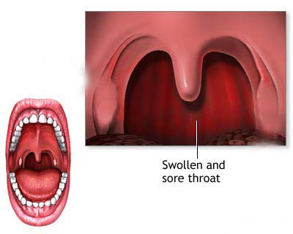
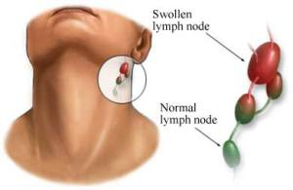
Swollen And Sore Throat
For the use of regd. Medical practitioner only
PURE HONEY
Natural Herbs

Slide 5
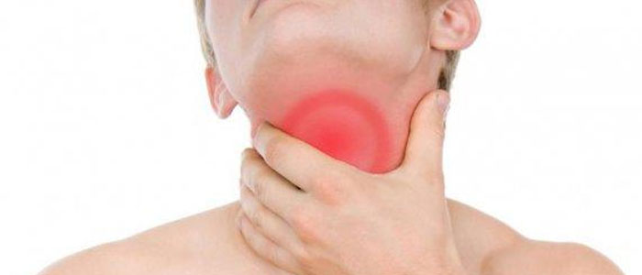

What Is a Sore Throat?
A Sore Throat Refers To Pain, Itchiness, Or Irritation Of The Throat. You May Have
Difficulty Swallowing Food And Liquids,
And The Pain May Get Worse When You
Try To Swallow. Throat Pain Is The Primary Symptom Of A Sore Throat. However, Other Symptoms May Include A Dry Throat, Swollen Glands In The Neck, White Patches On The Tonsils, And Hoarseness.
For the use of regd. Medical practitioner only
Sore Throat Can Affect People Of All Ages
A Sore Throat Can Affect People Of All Ages —however, The Risk Of A Sore Throat Is Higher In Some People. This Includes Children, Smokers, Allergy Sufferers, And People With A Compromised Immune System. Sharing A Close Space With Others Also Increases The Risk Of Upper Respiratory Infections That Can Present Initially As A Sore Throat.
PURE HONEY
Natural Herbs

Slide 6





100 ml
For the use of regd. Medical practitioner only

